Slide 1
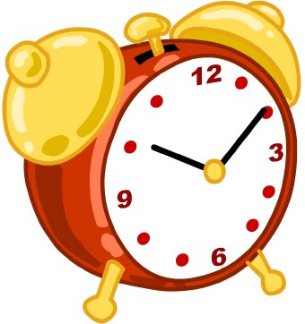
¿A qué hora?
At what time?
Senorita Fisher
DPA Middle Spanish
This Photo by Unknown Author is licensed under CC BY-ND

Slide 2
Let’s Review our numbers!!!
This Photo by Unknown Author is licensed under CC BY-NC-ND

Slide 3
“At” = “A”
A la una de la tarde (At 1:00pm)
A las doce de la noche (At 12:00am)
A las cinco de la manana (At 5:00am)

Slide 4
Clase, que quiere decir “A”?
This Photo by Unknown Author is licensed under CC BY-NC-ND
This Photo by Unknown Author is licensed under CC BY-NC-ND
This Photo by Unknown Author is licensed under CC BY-NC-ND

Slide 5
Rule: “A la” when you are talking about 1:00 and “A las” when yo are talking about 2:00-12:00”

Slide 6
“A la” or “A las”?
1:30
4:00
5:45
2:10
A la
A las
A las
A las

Slide 7
De la manana

Slide 8
De la tarde
This Photo by Unknown Author is licensed under CC BY

Slide 9
De la noche
This Photo by Unknown Author is licensed under CC BY-SA

Slide 10
Cuando?
“de la manana” =
“de la tarde” =
“de la noche” =
In the morning
In the afternoon
In the evening

Slide 11
Como se dice
At 6:00pm
At 7:00am
At 3:00pm
A las seis de la noche
A las siete de la manana
A las tres de la tarde

